Slide 1
ZOMATO RESTAURANT CHAIN ANALYSIS
- By
Group-3

Slide 2
Problem Statement :
Factors affecting the Restaurant chain in Bengaluru.
Area wise food choices of people from Bangalore.
Most common restaurant chain in Bangalore.
Restaurants that support online order system.
Best budget restaurant.
Common type of restaurants.
Most preferred cuisines.
Table booking providers ratio.

Slide 3
Data Description:
Dataset belongs to ZOMATO website.
ZOMATO is an Indian multinational restaurant aggregator and food delivery company.
It consists of information of Bangalore restaurant chains.
It provides Menu, Reviews, ratings, Cuisines, Location, average cost.
It has 10000 records, and 18 columns.

Slide 4
DATA CLEANING
Data was in raw format.
Deletion of duplicate records.
Converting attributes with numeric data from NON-Numeric format to Numeric format.
NULL Values Treatment.
Categorical Data’s garbage value treatment.

Slide 5


Problem Solving Steps:
Updated custom column names.
Verified the data shape and data-type.
“RATINGS” column was split from “/”.
Conversion of Non Numeric columns to Numeric.
Conversion to Numeric with errors = “coerce”.
Checked the duplicate rows.
Deletion of Duplicated Rows.

Slide 6

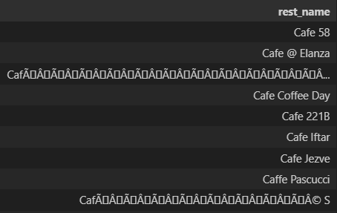
Replacement of garbage values for “Menu Item” & “Detail Reviews”.
Figured out garbage value from Restaurant Name column with “re” Library.
We realized that there is need for cleaning of
‘Restaurant name’ column.

Slide 7
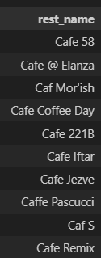
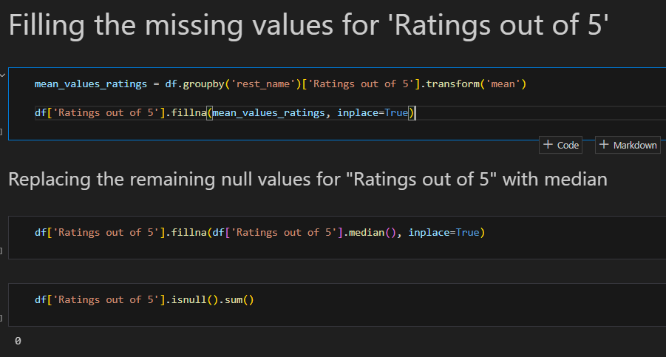
Removed the garbage value from “Restaurant Name”.
Cleaned the spelling mistakes for “CAFE”, i.e. ‘CAF’ to ‘CAFE’.
Missing Values check for non numeric.
Missing Values of “LOCATION” replaced by “Listed location in ZOMATO”
Missing value treatment using numeric columns using logical & mean/median imputation.

Slide 8
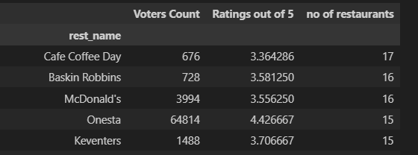
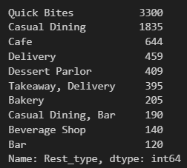
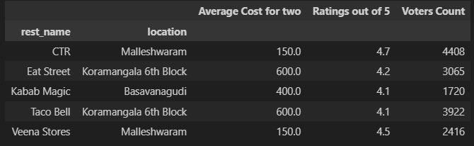
Found top restaurant chains based
on frequency.
Restaurant with no online order options.
Ratio of table booking availability.
Common type of restaurant.
Budget restaurants in different locations.
Top quick bites restaurants.
Plotted popular cuisine in Bangalore.

Slide 9
What could have been done better ?
Ratings without voters count.
More better treatment for “Restaurant type” column.
More detailed level Analysis.

Slide 10
Takeaways & conclusions:
Top to bottom approach.
Proper study of data and understanding.
Gain domain knowledge.
Scope of improvement.
Continuous learning.

Slide 11
THANK YOU!

